Slide 1
Step count using accelerometer sensor
Presented BY:
Aadil Ahmed Adam
Sindhuja G Naik

Slide 2
sensors
Accelerometer
Message sending
Alarm (vibration)

Slide 3
sensing
An instrument for measuring acceleration, typically that of an automobile, ship, aircraft, or that involved in the vibration of a machine, building, or other structure.
An accelerometer measures proper acceleration, which is the acceleration it experiences relative to freefall and is the acceleration felt by people and objects
Applications:
Engineering – vehicle acceleration
Industry – machinery health monitoring.
Human activities – walking, running etc.
Image stabilization - e.g.. Camcorders

Slide 4

Continued..

Slide 5
communication
An alert message can be sent to all the registered numbers when a particular device is used by an anonymous user. This can be used in various fields to ensure safety and security.

Slide 6
processing
After the values of the three coordinate system are being fetched, the calculation for counting the number of steps is done briefly using the above code snippet.
The values of x, y ,z axis are used to compute the number of steps taken by the user using the accelerometer sensor data.

Slide 7
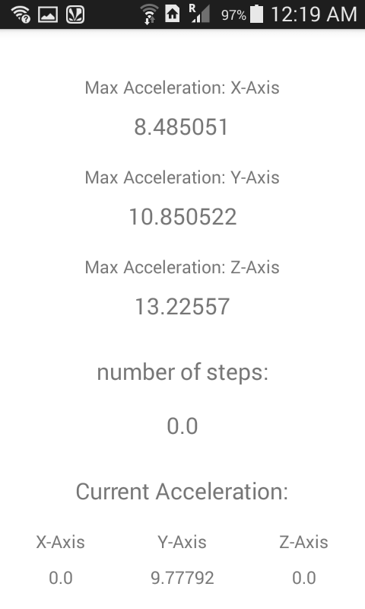
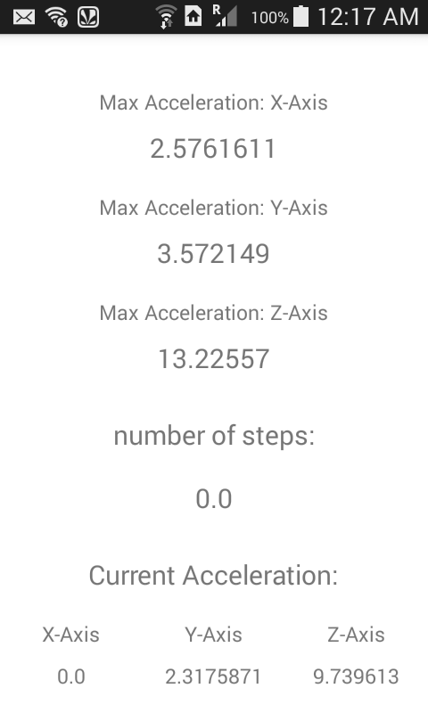
experiment

Slide 8
